Slide 1
Calculus Lesson 7

Slide 2
System | Derivative
A + B + C | [ ] + [ ] + [ ]
A * B * C | [ ] + [ ] + [ ]
A^(B^C) | [ ] + [ ] + [ ]
A^B / C | [ ] + [ ] + [ ]
Three inputs, 3 changing perspectives to include

Slide 3
George
Frank

Slide 4
dg
f • dg
df • dg
g
g • df
f
df

Slide 5
Slicing A Cake Among Friends
A
B
C
Cake
New person?
Cut a slice from everyone
A
B
C
D

Slide 6
Slicing A Cake Among Friends
Cake
A
B
A
B
C
New person?
Cut a slice from everyone
A
B
C
D

Slide 7
Scenario With 3 Parts
Change Simplifies To
A
+
B
+
C
A
*
B
*
C
A’s changes
B’s changes
C’s changes
+
+
A
^
B
^
C
A
*
B
/
C
…

Slide 8
Scenario With 2 Parts
F
+
G
F
*
G
Simplifies to
F’s changes
G’s changes
+
F
^
G
F
/
G
…

Slide 9
Scenario With 3 Parts
A’s changes
B’s changes
C’s changes
A
*
B
*
C
+
+

Slide 10
Scenario With 2 Parts
F’s changes
G’s changes
+
F
+
G
F
*
G
Simplifies to
Convert df to dx
Convert dg to dx
F
^
G
X’s changes
X’s changes
F
/
G
+
…

Slide 11
F’s changes
G’s changes
+
Convert df to dx
Convert dg to dx
X’s changes
X’s changes
+

Slide 12
Hours
Seconds
G’s changes
Seconds/Hour
Convert dg to dx
X’s changes
X’s changes
+
If you stop analyzing at A… then A’ = 1
dA/dA = 1
[ f(g(x)) ]’ = f’(g(x)) * g’(x)
[ f(A) ]’ = f’(A) * A’
df/dx = df/dg * dg/dx
dollars/yen = dollars/euro * euro/yen

Slide 13
derivative of
derivative of
(x + 3)
*
(2x + 7)
=
f
*
g
=
f
*
dg
+
g
*
df
dg/dx = 2
df/dx = 1
(x + 3)
2dx
(2x + 7)
1dx

Slide 14
derivative of
derivative of
(x² + 3x + 1)⁶
=
a
⁶
=
6
a
⁵
da/dx = 2x + 3
(x² + 3x + 1)
2dx

Slide 15
Paint $
F’s changes
df/dx
x’s changes
df’s changes
df/dx
dx’s changes
dg’s changes
dg ----- dx
dx’s
changes

Slide 16
Wood $
Paint $
+
Convert Wood $ to ¥
Convert Paint $ to ¥
Wood ¥
Paint ¥
+

Slide 17
F’s Changes
G’s Changes
+
Convert df to dx
Convert dg to dx
X’s changes
X’s changes
+

Slide 18
System | Derivative
A + B + C | [ ] + [ ] + [ ]
A * B * C | [ ] + [ ] + [ ]
A^(B^C) | [ ] + [ ] + [ ]
 | [ ] + [ ] + [ ]
Three inputs, 3 changing perspectives to include

Slide 19
Scenario With 2 Parts
Fuzzy Viewpoint
System | Derivative | Fuzzy Derivative
A * B * C | [ ] + [ ] + [ ]
A^(B^C) | [ ] + [ ] + [ ]
 | [ ] + [ ] + [ ]
A’s changes
+
B’s changes
A
+
B
…

Slide 20
x²
x²
x²

Slide 21
x²
x²
x²

Slide 23
dg
f * dg
g
g * df
f
df

Slide 24
Calculus Week 8

Slide 25
Interaction | Overall Change
Addition
Multiplication
Powers
Inverse
Division

Slide 26
Interaction | Overall Change | Analogy
Addition |  | Track changes from each part
Multiplication |  | Grow a rectangle
Powers |  | N viewpoints of “my change times the others”
Inverse |  | Sharing cake, new guy walks in
Division |  | Imagine f * (1/g)

Slide 27
X-Ray Strategy | Visualization | Step-by-Step Layout | Step Zoom In
Ring-by-ring
2 * pi * r
dr
r
(from 0 to r)
Symbolic |  | Solution | Step Zoom In
r
dr

Slide 28
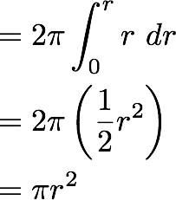
Strategy | Visualization | Step-by-Step Layout | Single Step Zoom
Ring-by-ring Timelapse
2πr
r
dr
Symbolic Description | Solution | Notes
Work backwards to the integral.
If
that means

Slide 29
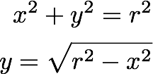
Strategy | Visualization | Height of Plate | Single Step Zoom
Plate-by-plate Timelapse
r
π y²
y
x
dx

Slide 30
Strategy | Visualization | Height of Plate | Single Step Zoom
Plate-by-plate Timelapse
r
π y²
y
x
dx
x

Slide 31
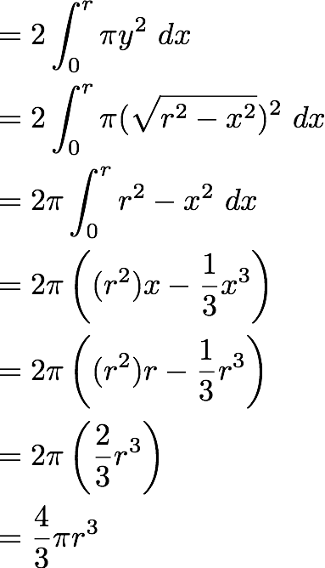
Symbolic | Solution | Notes
Write height in terms of x
Work backwards to find integrals
Find volume at full radius (x=r)

Slide 32
&= 2 \int_0^r \pi y^2 \ dx \\
&= 2 \int_0^r \pi (\sqrt{r^2 - x^2})^2 \ dx \\
&= 2 \pi \int_0^r r^2 - x^2 \ dx \\
&= 2 \pi \left( (r^2)x - \frac{1}{3}x^3 \right) \\
&= 2 \pi \left( (r^2)r - \frac{1}{3}r^3 \right) \\
&= 2 \pi \left( \frac{2}{3}r^3 \right) \\
&= \frac{4}{3} \pi r^3

Slide 33
Strategy | Visualization | Shell Analysis
Shell-by-shell X-Ray
Strategy | Visualization | Shell Analysis
Shell-by-shell X-Ray
dV
dr

Slide 34
Strategy | Visualization
Shell-by-shell X-Ray
volume change / thickness change

Slide 35
Symbolic | Solution | Notes
Express height (y) in terms of x
Work backwards to the integral
Get volume for full radius (x=r)

